Slide 1

Minecraft Classic Review
James Bland

Slide 2
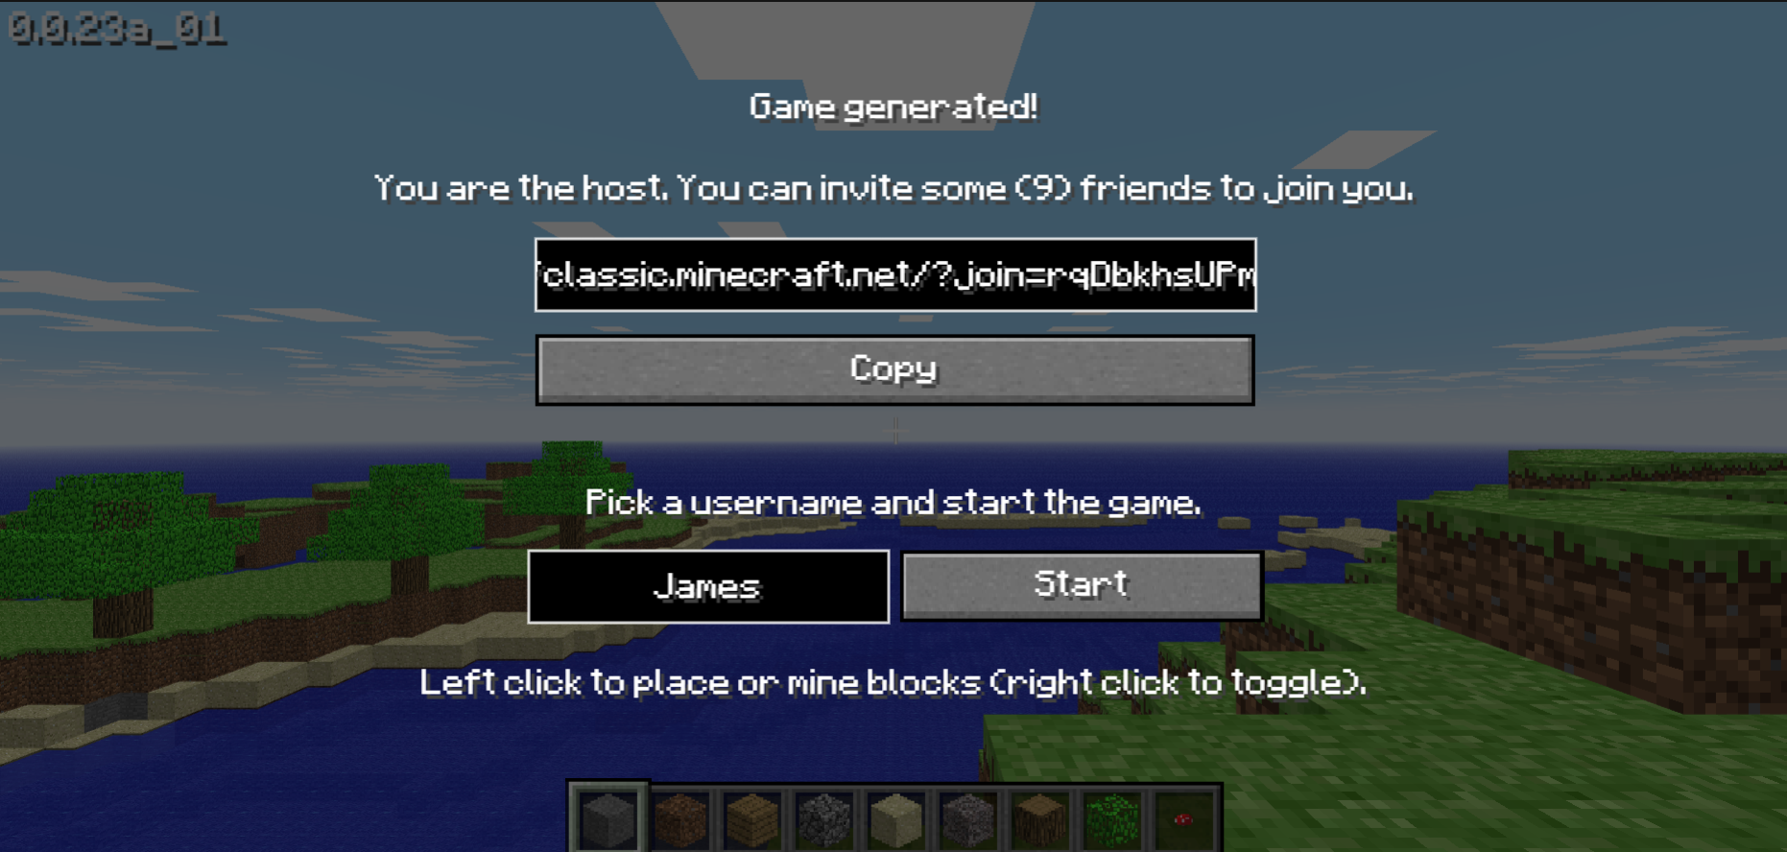
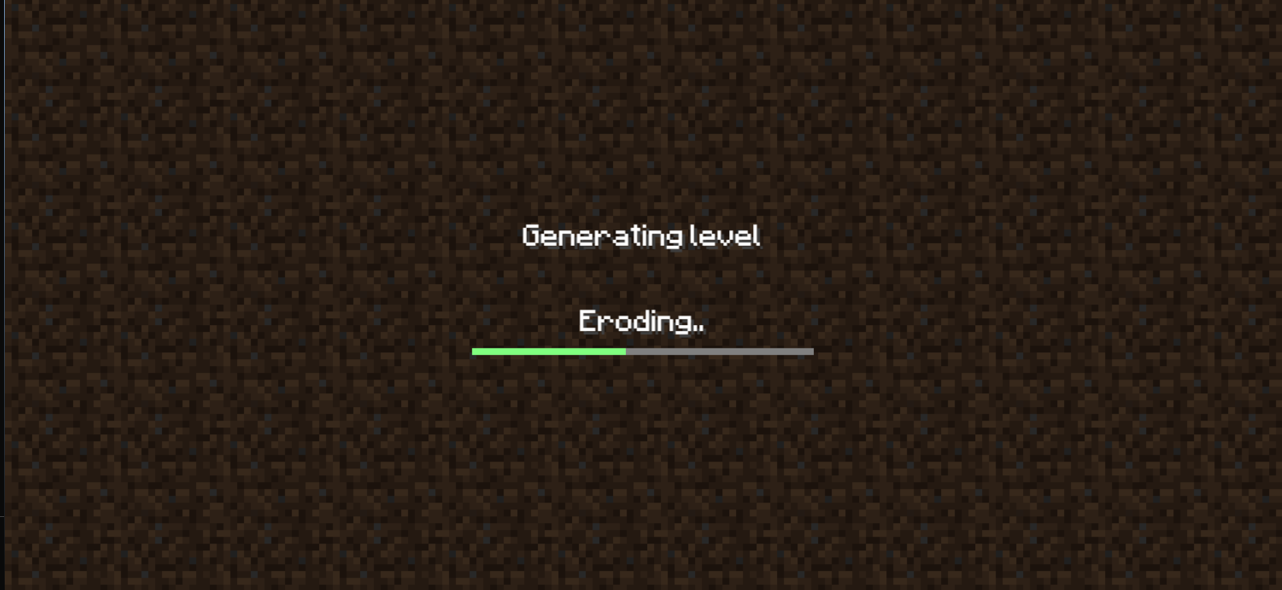
Website design (Good)
Well themed start page
Well themed loading screen

Slide 3
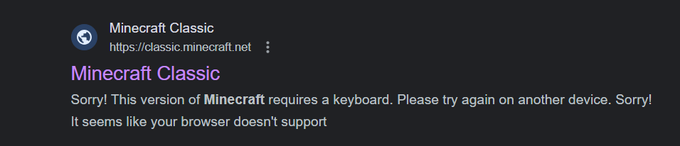
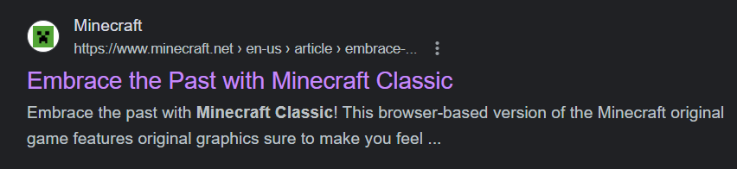
Website design (Bad)
The website doesn’t have a Favicon making it seem amateurish, unofficial and untrustworthy.
This website, in contrast, uses a favicon and so looks much more official

Slide 4
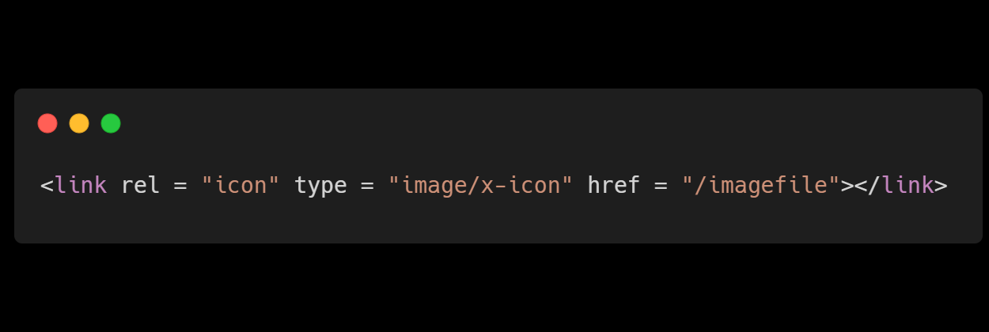
Improvement
Favicons are extremely easy to add
All the developers would have to do is add the following html tag to the website after the <title> tag.

Slide 5

Gameplay mechanics
The game is intended to be multiplayer with up to 10 players per lobby.
Almost any game is made better with friends
However it seems that the multiplayer features haven’t been working for some time, when trying to join a game the user is met with a white screen.

Slide 6
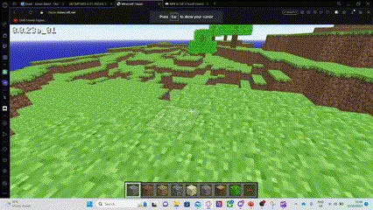
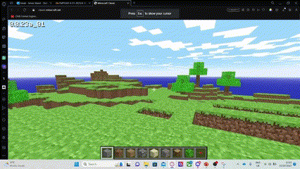
Gameplay mechanics
The player can use the keyboard (WASD) to move around and spacebar to jump, they can also hold space to swim up in water
The player can be in 2 modes, breaking blocks and building blocks. Right click can be used to swap between these modes.
This is somewhat intuitive to use, however I don’t see any advantage of this control scheme over how the desktop version of Minecraft handles placing and breaking blocks. (left click for deleting blocks and right click for building blocks)
The number keys or scrolling the mouse wheel can be used to select different blocks to place

Slide 7
Gameplay mechanics
There are no enemies in the game, it is just a sandbox game.
Therefore, there is nothing to balance
To add more difficulty the game could have been inspired by desktop Minecraft and implemented a day night cycle with Minecraft enemies such as zombies and creepers.
Additionally, I don’t like the way the game visualises the next block to be placed, as it is confusing and often gets in the way of the screen. Highlighting the block the player is hovering over is enough.

Slide 8

Graphics
The art style is exactly like classic Minecraft.
The simplistic art style makes the game very easy to process visually and can help to lower the barrier for entry and open the game up to more demographics.
The low detail, pixel-art textures used in the game make it perfect for the browser as these small textures are very performant.
The game runs easily in the browser

Slide 9
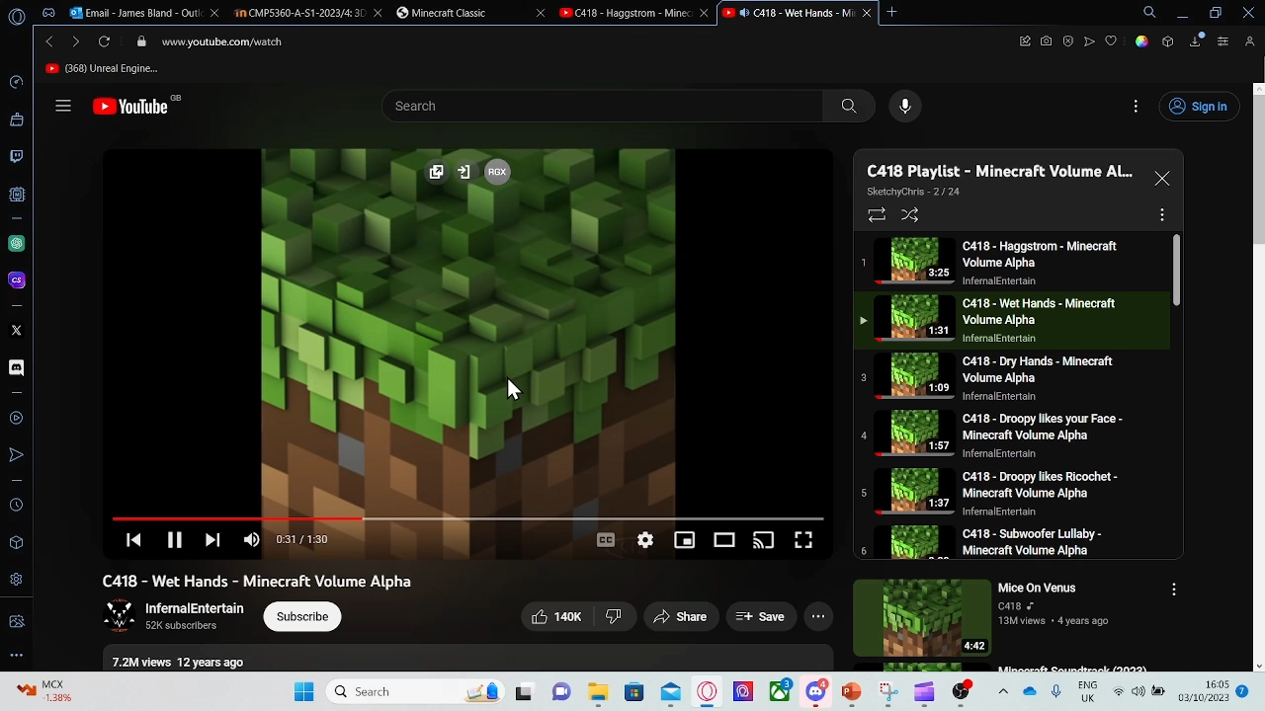
Music
The game has no music which is such a shame as the Minecraft theme music is iconic and massively contributes to the atmosphere of the game.
Without it the game feels kind of dead and empty
Figure 1 shows Minecraft's iconic theme and for anyone who has played the game the theme alone will likely bring back memories of playing the game
Figure 1 one of the iconic songs from Minecrafts OST

Slide 10

Sounds
The game has sounds for breaking blocks, however no sounds for placing them or walking.
The game should have sounds for placing blocks and walking ☹

Slide 11
Under the hood
The game uses HTML, CSS and Javascript
After using the inspector to view the source code I have found that this game uses WEBGL for rendering its graphics as it appears over 100 times in the source code.

Slide 12
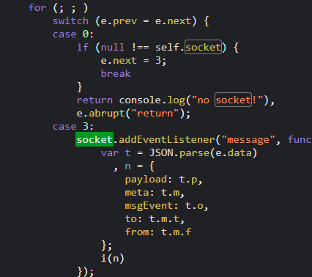
Under the hood
This section of the source code indicates web sockets are likely used for the multiplayer of the game
Websockets allows an application to make 1 connection to another which stays open and can be used to pass small amounds of data forwards and backwards quickly allowing the movements of both clients to synch up.
It is unclear what socket library the game uses however socket.io would be a good choice if the game was being developed today

Slide 13
Under the hood
Looking at the join code that you can send to your friends https://classic.minecraft.net/?join=axr9e-RzuTg8p9e7” you can see that the url is being used to pass parameters ?join=somevalue
In this case it is likely a socket room code which will be used to join the two players together

Slide 14
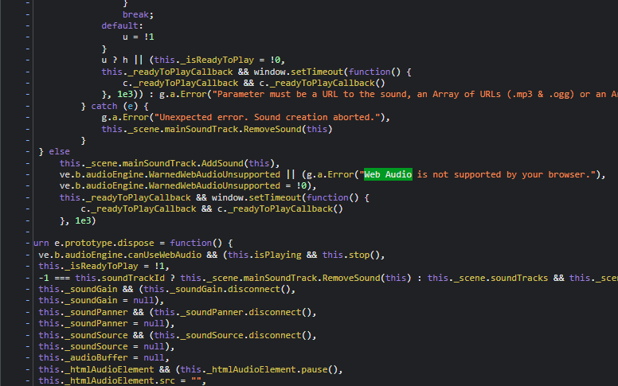
Under the hood
The source code seems to use the Web Audio Api to play sounds
“The Web Audio API provides a powerful and versatile system for controlling audio on the Web, allowing developers to choose audio sources, add effects to audio, create audio visualizations, apply spatial effects (such as panning) and much more.” - https://developer.mozilla.org/en-US/docs/Web/API/Web_Audio_API

Slide 15
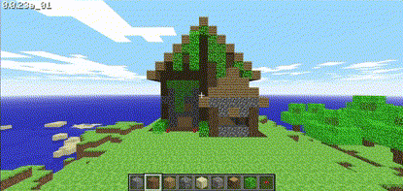
Most enjoyable parts of the game
I enjoyed making myself a house, the sandbox nature of the game is very appealing

Slide 16

Thank you for listening

